Slide 1
OPERATIONS DIVISION BI DASHBOARD
Visualising Data Analytics & Insight with Strong Security Measures
11th December 2025

Slide 2
WHY THE NEED OF BI DASHBOARD?
Part of COO’s Scorecard
Centralised in coordinating cross-division collaboration in clarifying budget movement.
Faster data-driven decision in validating numbers with respective domain owner.
Promotes efficiency of easy navigation with minor time consuming.
Secure where data is restricted to authorized users through role-based control.

Slide 3
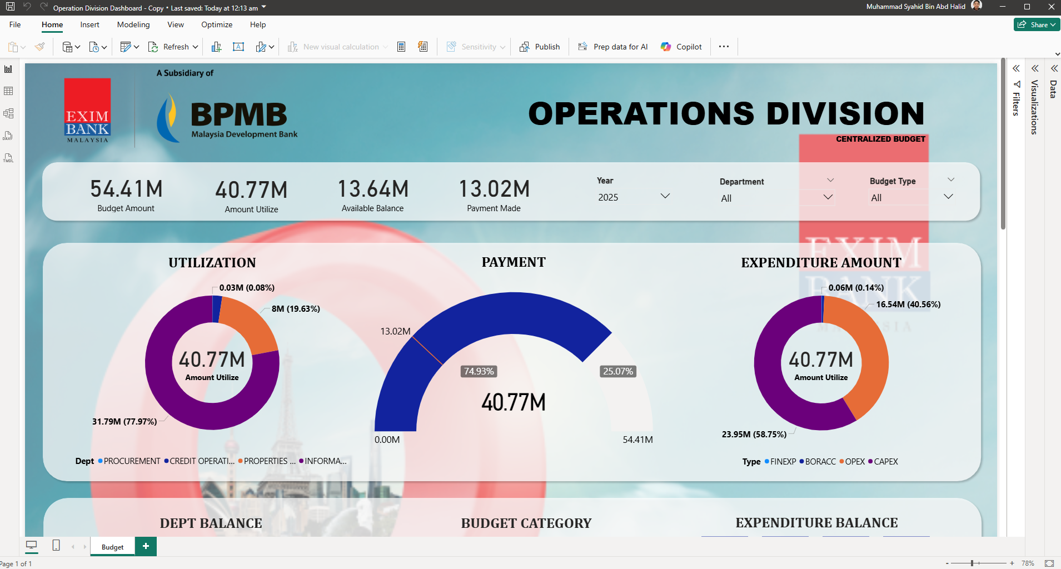
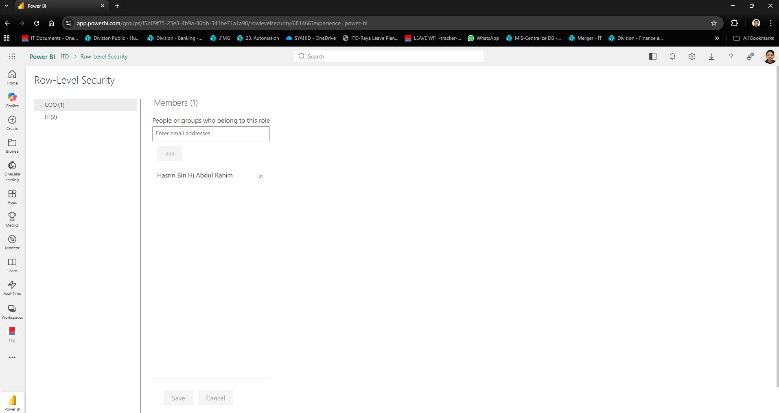
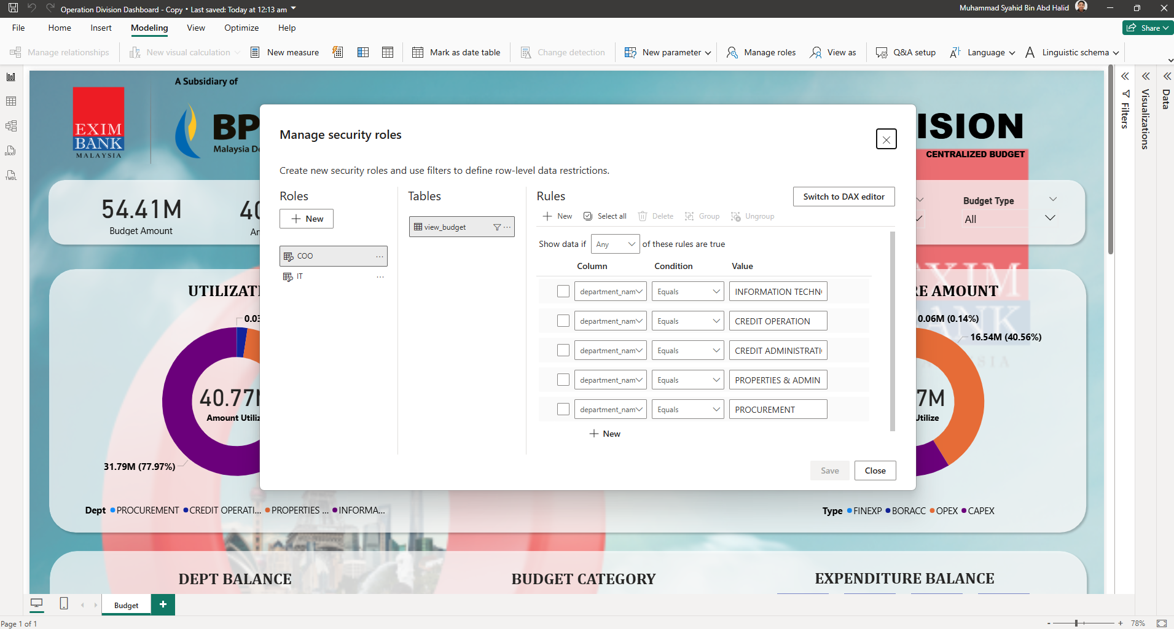
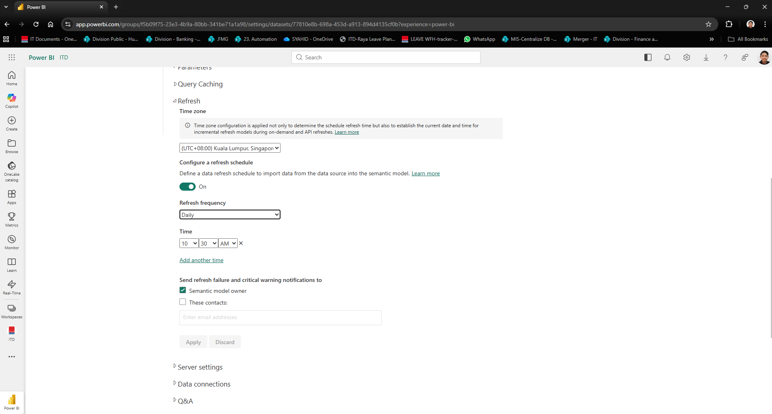
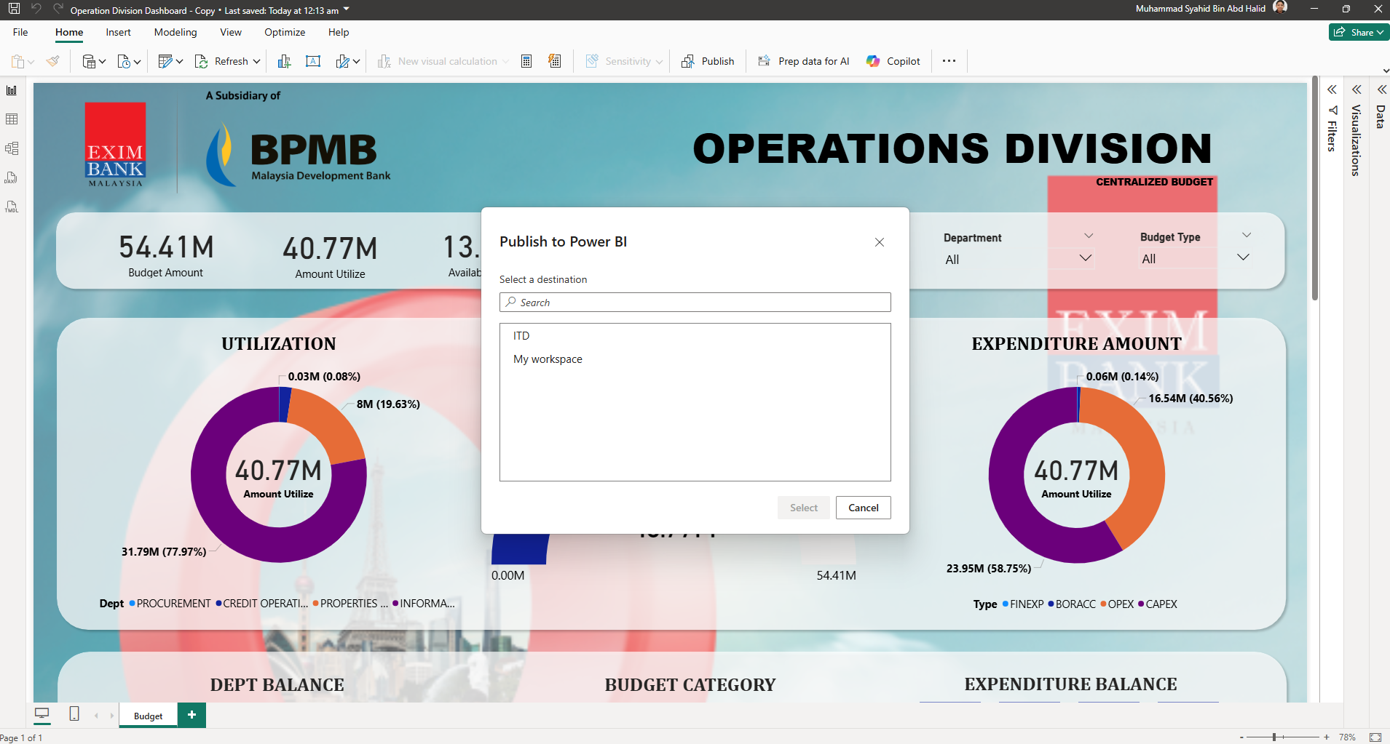
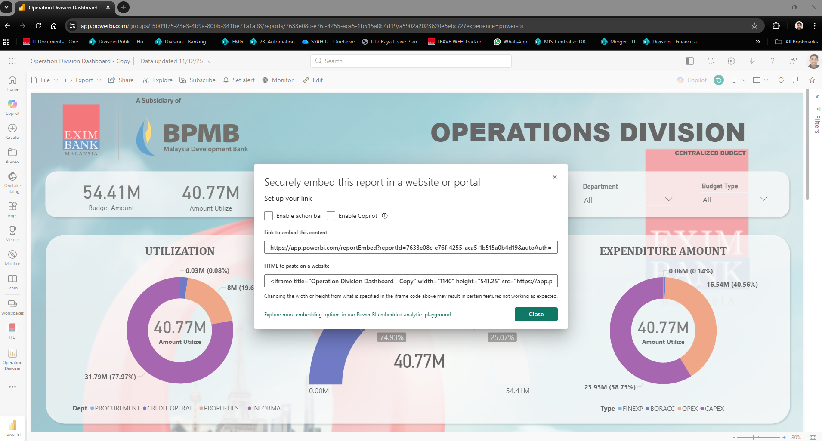
HOW TO PROVIDE A BI DASHBOARD?
Create a local Power BI dashboard
Create security roles within the local file
Publish to server
Apply security roles within the server
Set scheduled refresh
Shared dashboard via HTML for embedding
Success.

Slide 4
WHAT Can BE CONCLUDED FROM THE DASHBOARD?
From COO’s view (Primary)
Total budget utilized within the Operations Division FY2025 (RM40.77M).
Total budget requested FY2025 within the Operations Division FY2025 (188 Completed Budget).
Total under utilize budget FY2025 within the Operations Division FY2025 (77 Completed Budget).
Available budget balance FY2025 within the Operations Division FY2025 (RM13.64M).

Slide 5
NEXT?
To expand the dashboard usage throughout other system.
To utilize the dashboard daily operations and meetings.
To explore more advanced feature within Power BI.

Slide 6
Muhammad Syahid, Assistant Manager
syahidhalid@exim.com.my

